Slide 1


Course Code: HSS 461
Class: 5th Sem.
Course Title: Accounts & Finance
Class Day: Friday Timing:
08:30am to 10:30am
11:30am to 01:30pm
Lecture / Week No. 7
Instructor Name: Asim Iqbal
BAHRIA UNIVERSITY
Computer & Software Engineering Department

Slide 2
Table Of Contents
S.R# | Contents | Page #
1. | Describe and illustrate merchandising operations and the two types of inventory systems | 6
2. | Account for the purchase of inventory using a perpetual system | 14
3. | Account for the sale of inventory using a perpetual system | 29
4. | Adjust and close the accounts of a merchandising business | 42
5. | Prepare a merchandiser’s financial statements | 50
6. | Use gross profit percentage, inventory turnover, and days in inventory to evaluate a business | 57
7. | Account for the sale of inventory using a periodic system | 62
8. | Chapter 5 Summary | 68-72
9. | Reference | 75

Slide 3
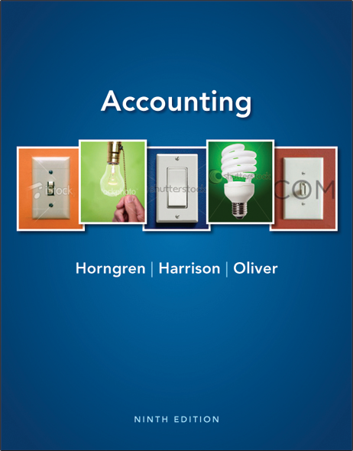
Merchandising Operations
Chapter 5
Notes:
Chapter 5 discusses merchandising operations.

Slide 4




Learning Objectives
 | Describe and illustrate merchandising operations and the two types of inventory systems
 | Account for the purchase of inventory using a perpetual system
 | Account for the sale of inventory using a perpetual system
 | Adjust and close the accounts of a merchandising business
Notes:
The objectives for this chapter include to:
1. Describe and illustrate merchandising operations and the two types of inventory systems.
2. Account for the purchase of inventory using a perpetual system.
3. Account for the sale of inventory using a perpetual system.
4. Adjust and close the accounts of a merchandising business.

Slide 5




Learning Objectives
 | Prepare a merchandiser’s financial statements
 | Use gross profit percentage, inventory turnover, and days in inventory to evaluate a business
 | Account for the sale of inventory using a periodic system (Appendix 5A)
 | Prepare worksheets for a merchandiser (see Appendix 5B, located at myaccountinglab.com)
Notes:
Additional objectives include to:
5. Prepare a merchandiser’s financial statements.
6.Use gross profit percentage, inventory turnover, and days in inventory to evaluate a business.
7. Account for the sale of inventory using a periodic system (Appendix 5A).
8. Prepare worksheets for a merchandiser (see Appendix 5B, located at myaccountinglab.com).

Slide 6
1
Describe and illustrate merchandising operations and the two types of inventory systems
Notes:
The first learning objective is to describe and illustrate merchandising operations and the two types of inventory systems.

Slide 7
Merchandisers
Businesses that sell a product to customers
New Accounts
Balance Sheet
Inventory
Asset account
Income Statement
Sales (Sales Revenue)
Cost of Goods Sold
Expense account
Notes:
Businesses that sell a product are called merchandisers because they sell merchandise, or goods, to customers. Merchandisers have an additional asset—merchandise inventory—that service companies don’t need. (The term merchandise is usually dropped and it’s simply referred to as inventory.) Inventory is defined as the merchandise that a company holds for sale to customers.
Merchandisers have some new balance sheet and income statement items.

Slide 8
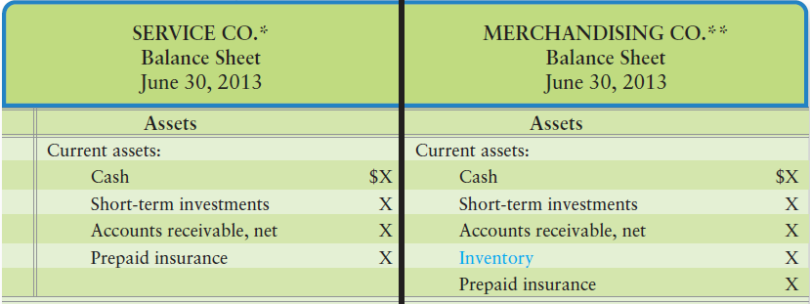
Balance Sheet Differences
* Smart Touch, in textbook Chapters 1-4, is a service company.
** Greg’s Tunes, in your textbook, is an example of a merchandising company.
Notes:
On the balance sheet, we have the Merchandise inventory (or Inventory) account, which is an asset.

Slide 9
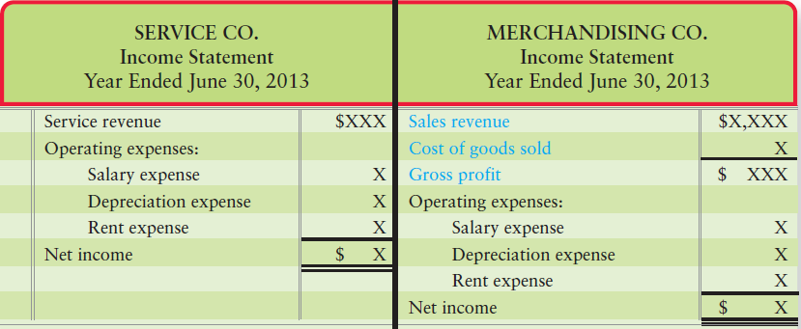
Income Statement Differences
Notes:
On the income statement, the revenue account is called Sales or Sales revenue. In addition, merchandisers have Cost of goods sold, an expense. Sales revenues is sometimes referred to as just Sales.

Slide 10
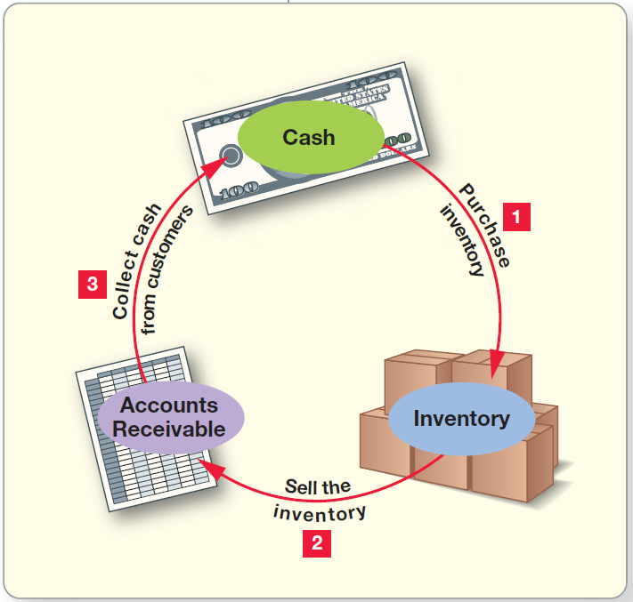
Operating Cycle
Notes:
The operating cycle of a merchandiser begins when the company purchases inventory from a vendor. A vendor is a supplier or wholesaler of merchandise. The company then sells the inventory to a customer. And, finally, the company collects cash from customers.

Slide 11
Inventory Systems
PERIODIC
Goods counted periodically to determine quantity
Used by small businesses
Less popular due to computerized inventory systems
Notes:
The periodic inventory system is normally used for relatively inexpensive goods. A small, local store without optical-scanning cash registers does not keep a running record of every loaf of bread or every key chain that it sells. Instead, the business physically counts its inventory periodically to determine the quantities on hand. Restaurants and small retail stores also use the periodic system. If you see a price tag on an item and the clerk rings the product up using that price tag, the operation is using a periodic inventory system. Appendix 5B covers the periodic system, which is becoming less popular because of increased reliance on computers.

Slide 12
Inventory Systems
PERPETUAL
Record of
Units purchased and cost amount
Units sold and sales and cost amounts
The quantity of inventory on hand and its cost
Better control of inventory
Popular due to bar codes
Physical count once a year
Notes:
The perpetual inventory system keeps a running computerized record of inventory—that is, the number of inventory units and the dollar amounts are perpetually (constantly) updated. This system achieves better control over the inventory. The count establishes the correct amount of ending inventory for the financial statements and also serves as a check against the perpetual records.
A modern perpetual inventory system records the following:
● Units purchased and cost amount
● Units sold and sales and cost amounts
● The quantity of inventory on hand and its cost

Slide 13
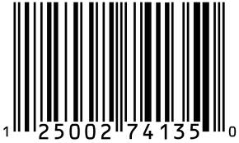

Bar Codes
Used to:
Record Sales and Cost of goods sold
Updates Inventory count
Updates purchasing and generates purchase orders
Notes:
The bar code systems used by businesses today can streamline MANY formerly repetitive and labor-intensive processes related to inventory. These perpetual trackers of inventory not only record sales revenue and cost of goods sold, they also communicate with the company’s purchasing systems to automatically generate paper or electronic purchase orders to replenish inventory. These systems allow merchandisers to keep a lean inventory system, which helps reduce the cost of acquiring, storing, and insuring inventory.

Slide 14
2
Account for the purchase of inventory using a perpetual system
Notes:
The second learning objective is to account for the purchase of inventory using a perpetual system.

Slide 15
Purchasing Inventory
The inventory account is increased with each purchase
The vendor submits an invoice for payment
The invoice contains:
The seller
The purchaser
The date of purchase (or shipment)
Credit terms
Total amount due
The due date
Notes:
The cycle of a merchandising entity begins with the purchase of inventory. The inventory account is increased each time merchandise is purchased. The invoice is the seller’s request for payment from the buyer. It indicates the quantity and cost of the items purchased. The cost of inventory is also impacted by shipping costs, returned or purchased items, and discounts for early payment.

Slide 16


Journal Entry for Purchase of Inventory
The Inventory account, an asset–used only for goods purchased
Debit for gross amount of purchase
The method of payment is credited
Accounts payable, if on account
Cash, if purchased with cash
Notes:
The entry to record the purchase of inventory on account includes a debit to Inventory and a credit to Accounts payable. If merchandise is purchased with cash, Cash would be credited. Supplies, equipment, and other assets are recorded in their own accounts.

Slide 17
Purchase Discounts
Discount for early payment
Expressed as follows:
Other terms:
2/10 , n/30
2% discount if paid within 10 days
Full amount due within 30 days
n/30
No discount, full amount due in 30 days
eom
Full amount due by the end of month
Notes:
Many businesses offer customers a discount for early payment. This is called a Purchase discount. Credit terms of “2% 10, NET 30 DAYS” mean that the buyer may deduct 2% from the total bill if the bill is paid within 10 days of the invoice date. Otherwise, the full amount—NET—is due within 30 days. These credit terms can also be expressed as “2/10, n/30.”
Terms of “n/30” mean that no discount is offered and payment is due 30 days after the invoice date. Terms of eom mean that payment is due at the end of the current month.

Slide 18
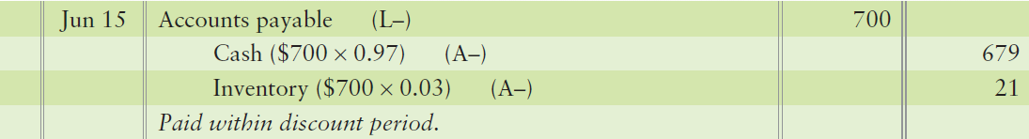
Payment within the Discount Period
Debit Accounts payable for invoice amount
Credit Cash for the actual payment amount (Gross amount – discount amount)
Credit Inventory for the discount amount
If payment is sent after the discount period
Credit cash for the full invoice amount
Do not reduce the inventory account
18
Notes:
The entry to record payment within the discount period, debit Accounts payable for the full amount of the invoice. The discount is credited to Inventory because the discount for early payment decreases the actual cost paid for Inventory. Cash is credited for the amount of the invoice less the discount. The net amount paid is the actual cost of the inventory; therefore, crediting inventory reduces the inventory account to its actual purchase cost.
If payment is sent after the discount period, Credit cash for the full invoice amount, but do not reduce the inventory account.

Slide 19
Purchase Returns and Allowances
Purchase return
Merchandise returned by the purchaser
Purchase allowance
Seller reduces amount owed
Incentive for purchaser to keep goods
Notes:
Businesses allow customers to return merchandise that is defective, damaged, or otherwise unsuitable. This is called a purchase return. Alternately, the seller may deduct an allowance from the amount the buyer owes. Purchase allowances are granted to the purchaser as an incentive to keep goods that are not “as ordered.” Together, purchase returns and allowances decrease the buyer’s cost of the inventory.

Slide 20
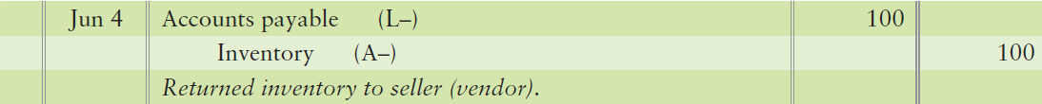
Journal Entry for Purchase Returns and Allowances
Debit Accounts payable for amount returned
Credit Inventory for the amount returned
Reverses original purchase entry
Entry the same for a purchase allowance
Company keeps the inventory
20
Notes:
The entry to record a purchase return or allowance is a debit to Accounts payable and a credit to Inventory. This is the opposite of the entry for a purchase. This entry decreases both the payable and inventory.
The exact same entry is made for a purchase allowance granted to the buyer from the seller (vendor). The only difference between a purchase return and a purchase allowance is that, in the case of the allowance, it keeps the inventory.

Slide 21
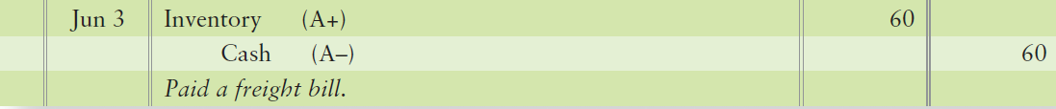
Transportation Costs
FOB Shipping Point
Buyer owns inventory when shipped
Purchaser normally pays freight charges
Freight in
Increases cost of inventory
21
Notes:
Someone must pay the transportation cost of shipping inventory from seller to buyer. The purchase agreement specifies FOB terms (free on board) to indicate who normally pays the freight. FOB terms also determine when title to the goods transfers to the purchaser.
FOB shipping point means the buyer takes ownership (title) to the goods at the shipping point. The buyer also pays the freight. FOB destination means the buyer takes ownership (title) at the delivery destination point. In that case, the seller normally pays the freight.
Freight costs are either freight in or freight out. Freight in is the transportation cost to ship goods IN the warehouse; thus, it is freight on purchased goods. Because paying the freight is a cost that must be paid to acquire the inventory, freight in becomes part of the cost of inventory. Freight out is the transportation cost to ship goods OUT of the warehouse; thus, it is freight on goods sold. This is an expense to the seller.

Slide 22
FOB Shipping Point
Seller
Buyer
Goods
Title transfers to buyer
Buyer pays freight charges
Increases cost of inventory
Notes:
This diagram provides a visual of FOB shipping point.

Slide 23
Transportation Costs
FOB Destination
Buyer owns inventory when goods arrive
Seller normally pays freight
Freight out
Selling expense to the seller
23
Notes:
FOB destination means the buyer takes ownership (title) to the goods at the delivery destination point. In this case, the seller (owner of the goods while in transit) usually pays the freight. Delivery expense is an operating expense and is debited to the Delivery expense account. Operating expenses are expenses (other than Cost of goods sold) that occur in the entity’s major line of business.

Slide 24
FOB Destination
Seller
Buyer
Goods
Title transfers to buyer
Seller pays freight charges
Increases expenses
Notes:
This diagram provides a visual of FOB destination.

Slide 25
Purchase Discount when Shipping Added to Invoice
Discount applied to inventory cost only
No discount computed on shipping cost
Notes:
Discounts are computed only on the merchandise purchased from the seller. Discounts are not computed on the transportation costs, because there is no discount on freight.

Slide 26
S5-2: Analyzing purchase transactions—perpetual inventory
Suppose KC Toys buys $185,800 worth of MegoBlock toys on credit terms of 2/10, n/30. Some of the goods are damaged in shipment, so KC Toys returns $18,530 of the merchandise to MegoBlock.
1. How much must KC Toys pay MegoBlock
After the discount period?
b. Within the discount period?
Original purchase amount $185,800
Less: Purchase returns 18,530
Cost of inventory kept by KC Toys $167,270
Cost of inventory kept by KC Toys $167,270
Less: Discount amount 3,345
Cost of inventory with discount $163,925
Notes:
Short Exercise 5-4 reviews purchase transactions in a perpetual inventory system.

Slide 27
S5-3: journalizing purchase transactions—perpetual inventory
Refer to the KC Toys facts in Short Exercise 5-2.
1. Journalize the following transactions. Explanations are not required.
a. Purchase of the goods on July 8, 2012.
b. Return of the damaged goods on July 12, 2012.
c. Payment on July 15, 2012.
July 8 | Inventory | 185,800
 | Accounts payable |  | 185,800
July 8 | Accounts payable | 18,530
 | Inventory |  | 18,530
July 8 | Accounts payable | 167,270
 | Inventory |  | 3,345
 | Cash |  | 163,925
Notes:
Short Exercise 5-3 continues with journalizing the purchase transactions from the previous slide.

Slide 28
S5-3: journalizing purchase transactions—perpetual inventory
Refer to the KC Toys facts in Short Exercise 5-2.
2. In the final analysis, how much did the inventory cost KC Toys?
Cost of inventory kept by KC Toys $167,270
Less: Discount amount 3,345
Cost of inventory with discount $163,925
Notes:
The exercise continues on this slide.

Slide 29
3
Account for the sale of inventory
using a perpetual system
Notes:
The third learning objective is to account for the sale of inventory using a perpetual system.

Slide 30
Sale of Inventory
Sales revenue
Amount earned from selling inventory
Revenue account
Cost of goods sold
Cost of inventory sold to customers
Expense account
Notes:
After a company buys inventory, the next step is to sell the goods. The amount a business earns from selling merchandise inventory is called Sales revenue (often abbreviated as Sales). A sale also creates an expense, Cost of goods sold, as the seller gives up the asset, Inventory. Cost of goods sold is the cost of inventory that has been sold to customers. Cost of goods sold (often abbreviated as Cost of sales) is the merchandiser’s major expense.

Slide 31
Accounting for Sales Transactions
Two journal entries:
Record the sale
Cash sale
Credit sale
Update the inventory
Notes:
To record sales of merchandise, two entries are needed. The first records the Sales revenue. If the sale is on account, Accounts receivable is debited. If it is for cash, Cash is debited. In either case, Sales revenue is credited. The second entry records the cost of merchandise by debiting Cost of goods sold. Since inventory is leaving the company, the Inventory account is credited.

Slide 32
Sale of Inventory issues
Sales returns and allowances
When customer returns goods or refuses services
Contra revenue account (debit balance)
Sales allowance
Seller grants a reduction in price to customer
Merchandise is defective, damaged, or otherwise unsuitable
Notes:
After making a sale on account, a company may experience a sales return where a customer returns goods or refuses services, or a sales allowance where the company may grant a sales allowance to entice the customer to accept non-standard goods. This allowance will reduce the cash to be collected from the customer. Both sales returns and allowances are debited to one account. This account is a contra revenue account with a normal debit balance.

Slide 33
Entry for Sales Returns and Allowances
Process the return (opposite of sale)
Sales returns and allowances (debit, reducing sales)
Refund Cash or reduce Accounts receivable (credit)
Increase inventory (debit, if returned and sellable)
Reduce Cost of goods sold (credit)
Process the allowance (same first entry)
Reduce Sales (Sales returns and allowances)
Refund Cash or reduce Accounts receivable
Notes:
If a customer returns an item or is granted an allowance, Sales returns and allowance is debited. The customer’s account receivable is reduced. If the transaction is a sales return, that is, the merchandise is physically returned to the company, a second entry is needed. The Inventory account is debited and Cost of goods sold is credited. If the transaction is a sales allowance, only the first entry is needed.

Slide 34
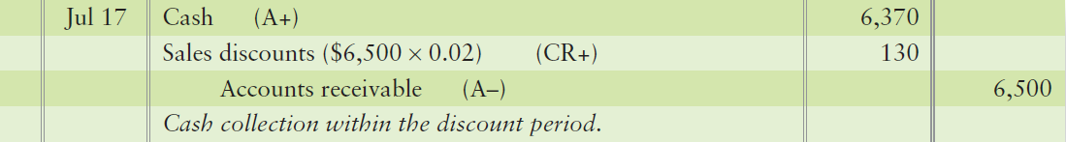
Entry for Sales Discounts
Sales discounts
Customer pays within the discount period
Seller has credit terms
Reduce Sales
(Contra revenue account)
Sales discount debited
Notes:
With a sales discount, if the customer pays within the discount period—under terms such as 2/10, n/30—the seller collects the discounted amount. If a company offers discount terms and the customer pays within the discount period, Sales discount is debited for the amount of the discount. Accounts receivable is credited for the full customer balance (less any returns). Cash is debited for the actual amount received (difference between the receivable and the discount).

Slide 35
Net Sales
Sales made to customers
minus
Sales Returns & Allowances
minus
Sales Discounts
equals
Net Sales
Notes:
Companies maintain separate accounts for Sales discounts and Sales returns and allowances so they can track these items separately. Net Sales revenue is calculated as:
Sales made to customers – Sales returned by customers (or allowances granted to customers) – Discounts given to customers who paid early = Net sales.
Notice that all selling transactions utilize accounts beginning with “S,” such as Sales revenue, Sales returns and allowances, and Sales discounts.

Slide 36
Gross Profit or Gross Margin
Net Sales
minus
Cost of Goods Sold
equals
Gross Profit
Notes:
Net sales, cost of goods sold, and gross profit are key elements of profitability. Net sales revenue minus cost of goods sold is called gross profit, or gross margin. You could also think of gross profit as the mark-up on the inventory; it is the extra amount the company received from the customer over what the company paid to the vendor. The gross profit must cover the company’s operating expenses for the company to survive. Gross profit, along with net income, is a measure of business success. A sufficiently high gross profit is vital to a merchandiser.

Slide 37
S5-6 : Journalizing sales transactions—perpetual inventory
Suppose Piranha.com sells 2,500 books on account for $15 each (cost of these books is $22,500) on October 10, 2012. One hundred of these books (cost $900) were damaged in shipment, so Piranha.com later received the damaged goods as sales returns on October 13, 2012. Then the customer paid the balance on October 22, 2012. Credit terms offered to the customer were 2/15, net 60.
Requirement
1. Journalize Piranha.com’s October 2012 transactions.
Notes:
Short Exercise 5-6 is an example of journalizing sales transactions in a perpetual inventory system.

Slide 38
S5-6 : Journalizing sales transactions—perpetual inventory
Recall that Piranha.com sells 2,500 books on account for $15 each (cost of these books is $22,500) on October 10, 2012.
Now, journalize cost of goods sold.
Oct 10 | Accounts Receivable | 37,500
 | Sales revenue |  | 37,500
Oct 10 | Cost of goods sold | 22,500
 | Inventory |  | 22,500
Notes:
The exercise continues on this slide.

Slide 39
S5-6 : Journalizing sales transactions—perpetual inventory
Now, one hundred of these books (cost $900) were damaged in shipment, so Piranha.com later received the damaged goods as sales returns on October 13, 2012.
Journalize cost of goods returned
Oct 13 | Sales returns and allowances | 1,500
 | Accounts receivable |  | 1,500
Oct 13 | Inventory | 900
 | Cost of goods sold |  | 900
Notes:
The exercise continues on this slide.

Slide 40
S5-6 : Journalizing sales transactions—perpetual inventory
Then the customer paid the balance on October 22, 2012.
Credit terms offered to the customer were 2/15, net 60.
Oct 22 | Cash | 35,280
 | Sales discount | 720
 | Accounts receivable |  | 36,000
Notes:
The exercise continues.

Slide 41
S5-7: Calculating net sales and gross profit—perpetual inventory
Calculate net sales revenue for October 2012.
2. Calculate gross profit for October 2012.
Gross sales revenue | $ 37,500
Less: Sales returns | (1,500)
Sales discount | (720)
Net sales revenue | $ 35,280
Net sales revenue | $ 35,280
Less: Cost of goods sold | (21,600)
Gross Profit | $ 13,680
Notes:
Short Exercise 5-7 reviews how to calculate sales and gross profit in a perpetual inventory system.

Slide 42
4
Adjust and close the accounts
of a merchandising business
Notes:
The fourth learning objective is to adjust and close the accounts of a merchandising business.

Slide 43
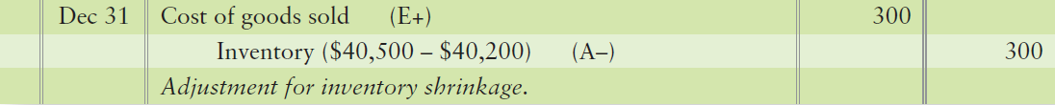
Adjusting Inventory
Physical count of inventory at least once per year
Account may differ from the books due to:
Theft or damage – Inventory shrinkage
Errors
Notes:
The Inventory account should stay current at all times in a perpetual inventory system. However, the actual amount of inventory on hand may differ from what the books show. Theft, damage, and errors occur. For this reason, businesses take a physical count of inventory at least once a year. The most common time to count inventory is at the end of the fiscal year. The business then adjusts the Inventory account based on the physical count. The entry to record the difference between the physical count of inventory and the amount in the account records includes a debit to Cost of goods sold and a credit to Inventory.

Slide 44
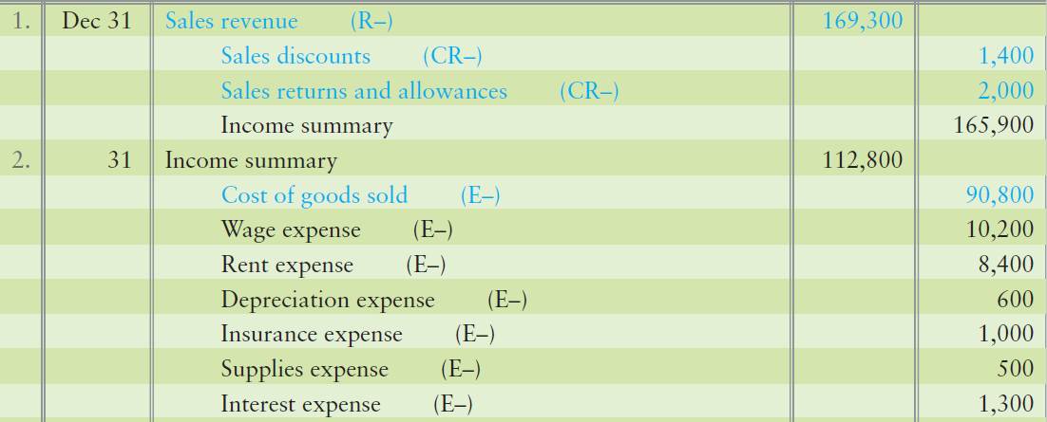
Closing Entries of Merchandiser
1. Close revenues and contra revenues
2. Close expenses
Notes:
Remember, closing means to zero out all accounts that aren’t on the balance sheet. The four-step closing process for a merchandising company is to:
1. Step 1 is to make the revenue accounts equal zero via the Income summary account. This closing entry transfers total revenues to the credit side of Income summary, $62,500.
2. Step 2 makes expense accounts and contra revenues equal zero via the Income summary account. This closing entry transfers total expenses and contra revenues (debit balance accounts) to the debit side of Income summary, $32,900.

Slide 45
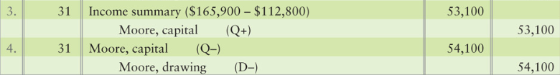
Closing Entries of a Merchandiser
3. Close Income summary
4. Close Drawing
Notes:
3. In Step 3, make the Income summary account equal zero via the Retained earnings account. This closing entry transfers net income (or net loss) to Retained earnings.
4. In Step 4, make the Dividends account equal zero via the Retained earnings account. This entry transfers the dividends to the debit side of Retained earnings.

Slide 46
S5-8 :Adjusting inventory for shrinkage
Rich’s Furniture’s Inventory account at year-end appeared as follows:
Inventory
Unadjusted balance 63,000
The physical count of inventory came up with a total of $61,900.
1. Journalize the adjusting entry.
 | Cost of goods sold | 1,100
 | Inventory |  | 1,100
Notes:
Short Exercise 5-8 focuses on adjusting inventory for shrinkage.

Slide 47
S5-9 : Journalizing closing entries—perpetual inventory
Carolina Communications, reported the following figures in its financial statements:
Cost of goods sold $385,000 Accumulated depreciation $39,000
Accounts payable 17,000 Cash 43,000
Rent expense 21,000 Sales revenue 696,000
Building 108,000 Depreciation expense 12,000
Rockwell, capital 208,000 Rockwell, drawing 61,000
Inventory 261,000 Sales discounts 9,000
1. Journalize the required closing entries for Rockwell RV Center for December 31, 2012.
Dec 31 | Sales revenue | 696,000
 | Sales Discount |  | 9,000
 | Income summary |  | 687,000
Notes:
In Short Exercise 5-9, we journalize closing entries for a company using the perpetual inventory system.

Slide 48
S5-9 : Journalizing closing entries—perpetual inventory
Carolina Communications reported the following figures in its financial statements:
Cost of goods sold $385,000 Accumulated depreciation $ 39,000
Accounts payable 17,000 Cash 43,000
Rent expense 21,000 Sales revenue 696,000
Building 108,000 Depreciation expense 12,000
Rockwell, capital 208,000 Rockwell, drawing 61,000
Inventory 261,000 Sales discounts 9,000
Dec 31 | Income summary | 418,000
 | Cost of goods sold |  | 385,000
 | Rent expense |  | 21,000
 | Depreciation expense |  | 12,000
 | Sales discounts |  | 9,000
Notes:
The exercise continues on this slide.

Slide 49
S5-9 : Journalizing closing entries—perpetual inventory
Carolina Communications reported the following figures in its financial statements:
Cost of goods sold $385,000 Accumulated depreciation $ 39,000
Accounts payable 17,000 Cash 43,000
Rent expense 21,000 Sales revenue 696,000
Building 108,000 Depreciation expense 12,000
Rockwell, capital 208,000 Rockwell, drawing 61,000
Inventory 261,000 Sales discounts 9,000
 | Income summary | 269,000
 | Rockwell, capital |  | 269,000
 | Rockwell, capital | 61,000
 | Rockwell, drawing |  | 61,000
Notes:
The exercise continues.

Slide 50
5
Prepare a merchandiser’s financial statements
Notes:
The fifth learning objective is to prepare a merchandiser’s financial statements.

Slide 51
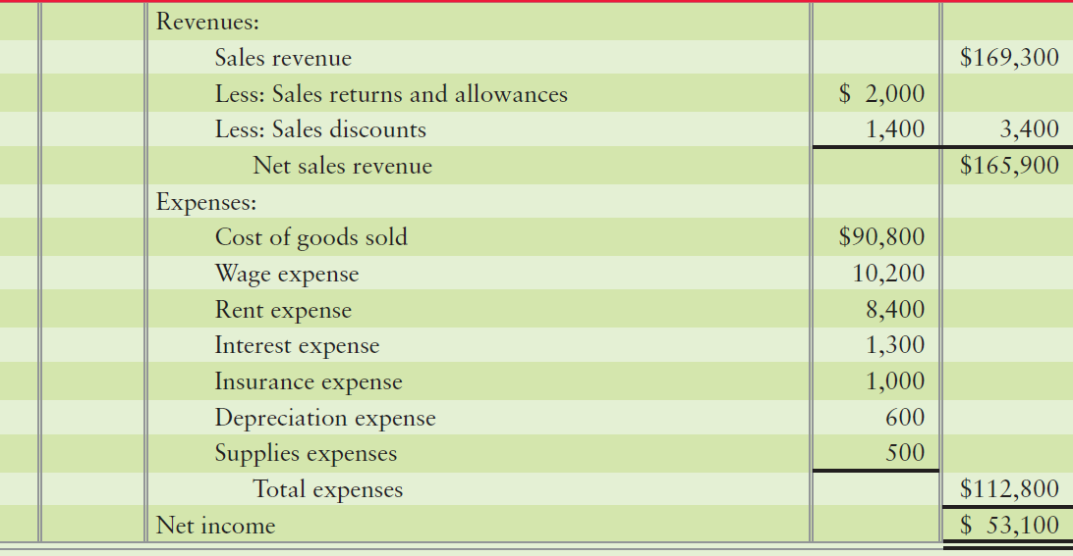
Single-Step Income Statement
Notes:
The income statement begins with Sales, Cost of goods sold, and Gross profit. Then come the operating expenses, which are those expenses other than Cost of goods sold. Operating expenses are all the normal expenses incurred to run the business, other than COGS.
Gross profit minus Operating expenses equals Operating income or Income from operations. Operating income measures the results of the entity’s major ongoing activities (normal operations).

Slide 52
Operating Expenses
Selling Expenses
Marketing and selling products
Includes:
Advertising
Sales’ salaries
Store rent, depreciation, taxes, utilities and insurance
Freight out or delivery expenses
Notes:
Both merchandisers and service companies report operating expenses in two categories. The first is selling expenses, those expenses related to marketing and selling the company’s products. These include sales salaries, sales commissions, advertising, depreciation, store rent, utilities on store buildings, property taxes on store buildings, and delivery expense.

Slide 53
Operating Expenses
General Expenses
NOT marketing products
Includes:
Executive and staff salary
Administrative office building rent, depreciation, taxes, utilities and insurance
Not store related
Notes:
The next category is general–those expenses not related to marketing the company’s products. These include office expenses, such as the salaries of the executives and office employees; depreciation; rent, other than on stores (for example, rent on the administrative office); utilities, other than on stores (for example, utilities on the administrative office); and property taxes on the administrative office building.

Slide 54
Other Financial Statements
Statement of Owner’s Equity
Same as service company
Balance Sheet
Inventory account
Current asset
Notes:
The preparation of the statement of retained earnings and the balance sheet are the same for merchandising as for service companies. The only difference is the addition of the asset account, Inventory, on the balance sheet.

Slide 55
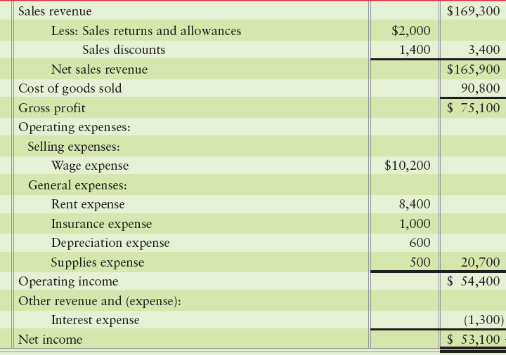
Income Statement Formats
Multi-step Income Statement
Lists several important subtotals
Gross profit
Operating income
More popular
Notes:
There are two formats for the income statement. A multi-step income statement lists several important subtotals. In addition to net income (the bottom line), it also reports subtotals for gross profit and income from operations. The income statements presented so far in this chapter have been multi-step, and multi-step format is more popular than single-step.

Slide 56
Income Statement Formats
Single-step
Groups all revenues and all expenses together
No subtotals
Works well for service companies
Notes:
The single-step income statement is the income statement format you first learned about in Chapter 1. It groups all revenues together and all expenses together, without calculating other subtotals. Many companies use this format. The single-step format clearly distinguishes revenues from expenses and works well for service entities because they have no gross profit to report.

Slide 57
6
Use gross profit percentage, inventory turnover, and days in inventory to evaluate a business
Notes:
The sixth learning objective is to use gross profit percentage, inventory turnover and days in inventory to evaluate a business.

Slide 58
Gross Profit Percentage
Calculation:
Carefully watched measure
Small increase may indicate rise in income
Small decrease may indicate trouble
Gross Profit
Net Sales Revenue
Notes:
Inventory is the most important asset for a merchandiser. Merchandisers use several ratios to evaluate their operations, among them the gross profit percentage, the rate of inventory turnover, and days in inventory.
Gross profit (gross margin) is net sales minus the cost of goods sold. Merchandisers strive to increase the gross profit percentage (also called the gross margin percentage).

Slide 59
Rate of Inventory Turnover
Calculation:
Measures how rapidly inventory is sold
The higher the turnover, the more quickly inventory is sold
Cost of goods sold
Average inventory
Notes:
Inventory turnover measures how rapidly inventory is sold. Owners and managers strive to sell inventory quickly because the inventory generates no profit until it is sold. Further, fast-selling inventory is less likely to become obsolete (worthless). The faster the inventory sells, the larger the income. Additionally, larger inventories mean more storage costs, more risk of loss, and higher insurance premiums. Therefore, companies try to manage their inventory levels such that they have just enough inventory to meet customer demand without investing large amounts of money in inventory sitting on the shelves gathering dust.

Slide 60
Days in Inventory
Calculation:
Measures average number of days inventory held
The higher the days, the longer inventory is being held
365 days
Inventory turnover ratio
Notes:
Another key measure is the number of days in inventory ratio. This measures the average number of days inventory is held by the company. Companies try to manage their inventory levels so that they have just enough inventory to meet customer demand without investing large amounts of money in inventory.

Slide 61
E5-25: Calculating gross profit percentage and inventory turnover to evaluate a business
LanWan Software earned sales revenue of $65,000,000 in 2012. Cost of goods sold was $39,000,000, and Net income reached $9,000,000, the company’s highest ever. Total current assets included Inventory of $3,000,000 at December 31, 2012. Inventory was $5,000,000 on December 31, 2011.
Compute the company’s gross profit percentage for 2012
Compute the rate of inventory turnover for 2012
Gross Profit
Net Sales Revenue
65,000,000 – 39,000,000 26,000,000
65,000,000 65,000,000
=
=
=
40%
Cost of goods sold
Average inventory
39,000 ,000
(5,000,000 + 3,000,000) /2
39,000,000
4,000,000
=
=
=
9.75
Notes:
Exercise 5-25 addresses the calculation of gross profit percentage and inventory turnover.

Slide 62
7
Account for the sale of inventory using
a periodic system (Appendix 5A)
Notes:
The sixth learning objective is to use gross profit percentage and inventory turnover to evaluate a business.

Slide 63

Inventory Using a Periodic System
Periodic system has separate accounts for:
Purchases
Purchases discount
Purchase returns and allowance
Transportation cost
Notes:
During the period, the business records the cost of all inventory bought in the Purchases account. The balance of Purchases is a gross amount because it does not include subtractions for discounts, returns, or allowances. All inventory systems use the Inventory account. But in a periodic system, Purchases, Purchase discounts, Purchase returns and allowances, and Transportation costs are recorded in separate accounts.

Slide 64
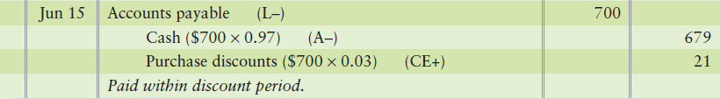

Purchase Discounts and Purchase Returns and Allowances
Separate purchase discount account
Purchase returns and allowance
Notes:
The entry to record the purchase and payment on account within the discount period includes a separate purchases discount account.

Slide 65
Net Purchases
Purchases (debit)
minus
Purchase discounts (credit)
minus
Purchase returns and allowances (credit)
equals
Net purchases
Notes:
During the period, the business records the cost of all inventory bought in the Purchases account. The balance of purchases is a gross amount because it does not include subtractions for discounts, returns, or allowances. Net purchases is the remainder after subtracting the contra accounts from Purchases

Slide 66

Freight In
Costs to transport purchased inventory are debited to Freight in, an expense account
Notes:
Under the periodic system, costs to transport purchased inventory from seller to buyer are debited to a separate Freight in account.

Slide 67
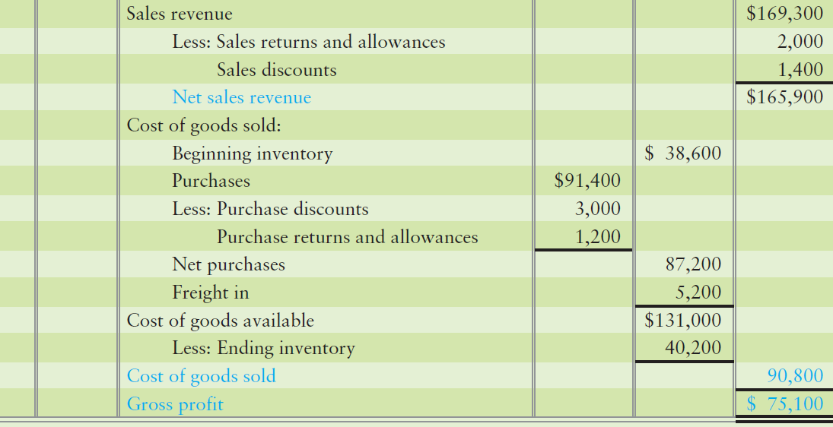
Cost of Goods Sold
Must be calculated under periodic system
Notes:
The amount of cost of goods sold is the same regardless of the inventory system—perpetual or periodic. Cost of goods sold is computed differently under the periodic system. At the end of each period, the company combines a number of accounts to compute cost of goods sold for the period.

Slide 68
Chapter 5 Summary
If a company is using a price tag stamped on the good to ring up your purchase, the company is probably using a periodic inventory system. If a company is using a bar code scanner to ring up your purchase, the company is using a perpetual inventory system.
All purchase transactions are between the company and a vendor. In a perpetual system, every transaction that affects the quantity or price of inventory is either debited or credited to the asset, Inventory, based on the rules of debit and credit.
Notes:
If a company is using a price tag stamped on the good to ring up your purchase, the company is probably using a periodic inventory system. If a company is using a bar code scanner to ring up your purchase, the company is using a perpetual inventory system. All purchase transactions are between the company and a vendor. In a perpetual system, every transaction that affects the quantity or price of inventory is either debited or credited to the asset, Inventory, based on the rules of debit and credit.

Slide 69
Chapter 5 Summary
Increases debit Inventory (increase in quantity or cost per unit). Decreases credit Inventory (decrease in quantity or cost per unit).
All sales transactions are between the company and a customer. In a perpetual system, each sales transaction has two entries. The first entry records the sales price to the customer (debit Cash or Accounts receivable and credit Sales revenue). The second entry updates the Inventory account (debit COGS and credit Inventory).
Notes:
Increases debit Inventory (increase in quantity or cost per unit). Decreases credit Inventory (decrease in quantity or cost per unit). All sales transactions are between the company and a customer. In a perpetual system, each sales transaction has two entries. The first entry records the sales price to the customer (debit Cash or Accounts receivable and credit Sales revenue). The second entry updates the Inventory account (debit COGS and credit Inventory).

Slide 70
Chapter 5 Summary
When customers return goods, two entries are made. The first entry records the returned goods from the customer at their sales price (debit Sales returns and allowances and credit Cash or Accounts receivable). The second entry updates the Inventory account (debit Inventory and credit COGS). When customers pay early to take advantage of terms offered, it reduces the amount of cash the company receives and a Sales discount is recorded.
Notes:
When customers return goods, two entries are made. The first entry records the returned goods from the customer at their sales price (debit Sales returns and allowances and credit Cash or Accounts receivable). The second entry updates the Inventory account (debit Inventory and credit COGS). When customers pay early to take advantage of terms offered, it reduces the amount of cash the company receives and a Sales discount is recorded.

Slide 71
Chapter 5 Summary
Closing entries are made at the end of a period to all accounts that are temporary (not on the balance sheet). To close an account means to make the balance zero.
The form of the income statement can give users more information for decisions. The multi-step income statement, with more subtotals, has more value than the single-step income statement. Regardless of the form, bottom line net income or loss is the same amount.
Notes:
Closing entries are made at the end of a period to all accounts that are temporary (not on the balance sheet). To close an account means to make the balance zero.
The form of the income statement can give users more information for decisions. The multi-step income statement, with more subtotals, has more value than the single-step income statement. Regardless of the form, bottom line net income or loss is the same amount.

Slide 72
Chapter 5 Summary
The preparation of the statement of owner’s equity and the balance sheet are the same for merchandising as for service companies. The only difference is the addition of the asset account, Inventory, on the balance sheet.
Ratios serve as an alternate way to measure how well a company is managing its various assets.
Notes:
The preparation of the statement of retained earnings and the balance sheet are the same for merchandising as for service companies. The only difference is the addition of the asset account, Inventory, on the balance sheet.
Remember, ratios serve as an alternate way to measure how well a company is managing its various assets.

Slide 73

Notes:
Do you have any questions?

Slide 74

Copyright
All rights reserved. No part of this publication may be reproduced, stored in a retrieval system, or transmitted, in any form or by any means, electronic, mechanical, photocopying, recording, or otherwise, without the prior written permission of the publisher. Printed in the United States of America.

Slide 75
.
References / Resources
https://www.coursehero.com/file/24020599/Merchandising-Operations-and-Inventory-Systems/
https://www.accountingformanagement.org/perpetual-inventory-system/
https://www.investopedia.com/articles/investing/053115/understanding-periodic-vs-perpetual-inventory.asp
https://courses.lumenlearning.com/finaccounting/chapter/journalizing-adjusting-and-closing-entries-for-a-merchandising-enterprise/
https://courses.lumenlearning.com/sac-finaccounting/chapter/alternative-formats-and-terminology-for-financial-statements/
https://www.accountingformanagement.org/inventory-turnover-ratio/
https://www.accountingtools.com/articles/2017/5/13/periodic-inventory-system

